Slide 1


Portfolio Optimization Through Fibonacci Retracement and Monte Carlos Simulation
December 6, 2022
By: Kevin Wang

Slide 2
Background
Python History
Created by Guido Van Rossum on February 20, 1991 Named after BBC sketch comedy show Monty Python’s Flying Circus Used to build software, data analysis, and automate tasks
Concepts
Fibonacci Retracement – Method of technical analysis used to determine support and resistance levels Monte Carlos Simulation – Computational algorithm that uses repeated random sampling to determine results
Python Libraries Used
Pandas – Data Manipulation and Analysis Pandas Data Reader – Access public financial data Matplotlib – Plotting library to create interactive visuals NumPy – Performs a wide range of mathematical operations on arrays (Written in C) SciPy – Utility function for optimizing data (linear algebra)
Hypothesis
The FR levels can be used in a portfolio to determine support and resistance levels based on macroeconomic events The Monte Carlos Simulation can determine the optimal portfolio weighting consistently
Notes:
Risk Adj: CAPM (MRP*.98)+RF
Active Management: HPR – Risk Adj Return

Slide 3
Portfolio Description
Exxon Mobil (XOM)
Kinder Morgan (KMI)
Description: A multinational integrated oil and gas supermajor headquartered in Irving, Texas. They operate within the downstream, upstream, and chemical manufacturing segments.
Description: One of the largest providers of energy transportation and storage services in North America operating approximately 83,000 miles of pipelines and 143 terminals.
Current Price: $106.85 | 52 Week High: $114.66
Market Cap: $440.01bn | 52 Week Low: $57.96
P/E: 15.43 | Sector: Energy
Current Price: $18.56 | 52 Week High: $20.20
Market Cap: $41.72bn | 52 Week Low: $15.01
P/E: 16.80 | Sector: Energy
Chevron (CVX)
Energy Selected Sector (XLE)
Description: A U.S. based super major, CVX is one of the largest globally exposed integrated oil & gas companies in the world. The company generates most of its revenue from its Upstream segment.
Description: Consist of 26 holdings of the Energy sector. The top 10 holdings are ~73% of the fund’s assets. The XLE are energy companies within the broader SPY 500
30%
Current Price: $176.56 | 52 Week High: $189.68
Market Cap: $341.40B | 52 Week Low: $110.73
P/E: 10.04 | Sector: Energy
Current Price: $87.63 | 52 Week High: $94.71
Market Cap: $15.20bn | 52 Week Low: $51.66
P/E: N/A | Sector: Energy

Slide 4
Portfolio Description
Duke Energy (DUK)
Constellation Energy Corporation (CEG)
Description: Duke Energy is an electric utility company segmented into Electric Utilities and Infrastructure, Gas Utilities and Infrastructure, and Commercial Renewables operating across the Eastern United States.
Description: Headquartered in Baltimore, Maryland and founded in February 2022 after splitting off from its parent company, Exelon. CEG provides nuclear, hydro, wind, and solar energy services to approximately 2 million customers.
Current Price: $94.49 | 52 Week High: $113.20
Market Cap: $76.34bn | 52 Week Low: $85.94
P/E: N/A | Sector: Utilities
Current Price: $90.06 | 52 Week High: $97.89
Market Cap: $29.45bn | 52 Week Low: $37.63
P/E: N/A | Sector: Utilities
Dominion Energy (D)
Description: One of the nation’s largest providers and distributors of electricity, natural gas, and related services to customers primarily in the East Coast and Rocky Mountain regions of the U.S.
30%
Current Price: $59.27 | 52 Week High: $88.78
Market Cap: $49.39bn | 52 Week Low: $57.95
P/E: 21.35 | Sector: Utilities
70%

Slide 5
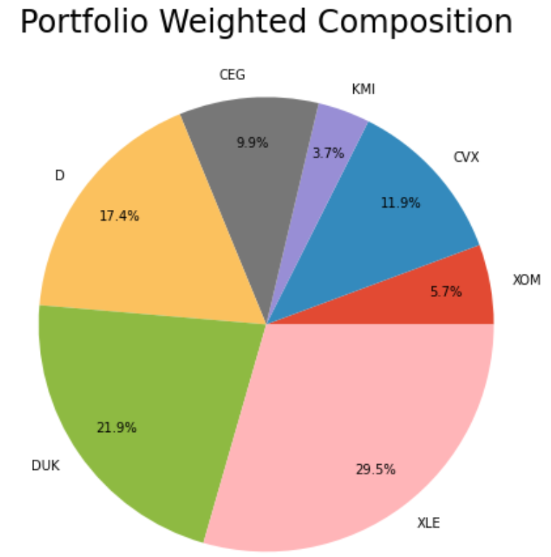
Portfolio Overview
Company | Shares
ExxonMobil (XOM) | 198
Chevron (CVX) | 252
Kinder Morgan (KMI)Duke | 747
Constellation Energy Corp (CEG) | 405
Dominion (D) | 1116
Duke (DUK) | 843
Energy ETF (XLE) | 1252
Total shares: 4813

Slide 6
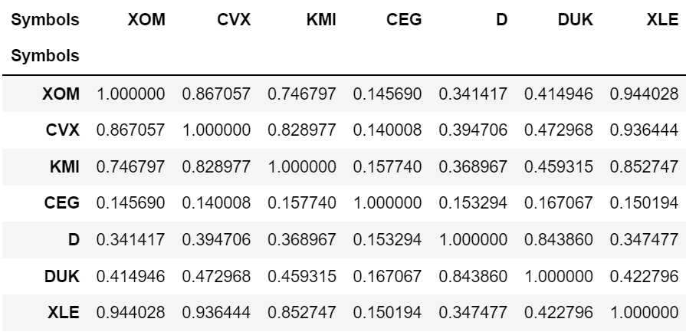
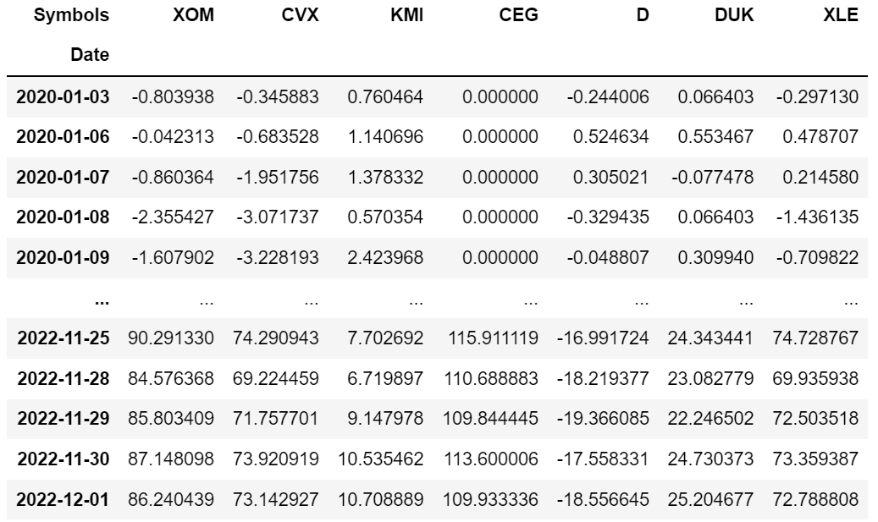
Portfolio Statistics
Sensitivity Analysis
Cumulative Return Dataframe
Portfolio Statistics Portfolio Value: ~380 Thousand dollars Time Horizon: 01/03/2020 – 12/01/2022 Cumulative Returns: 37.33%
Source: Bloomberg
Data as of 1/28/21 – 1/28/22

Slide 7
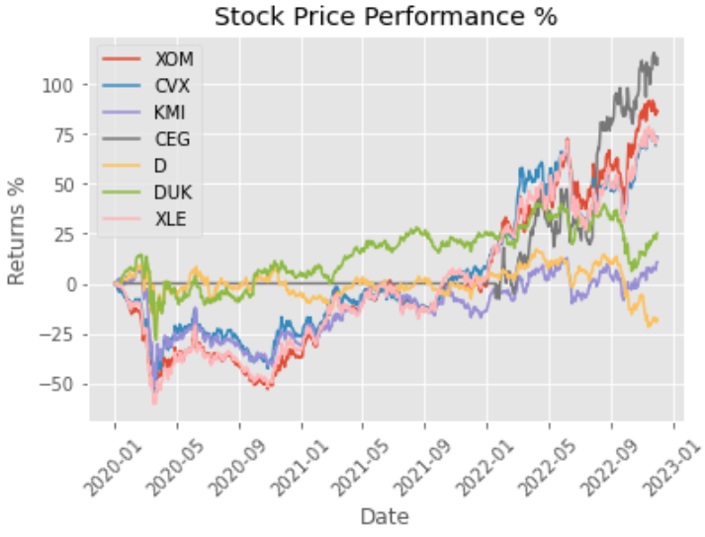
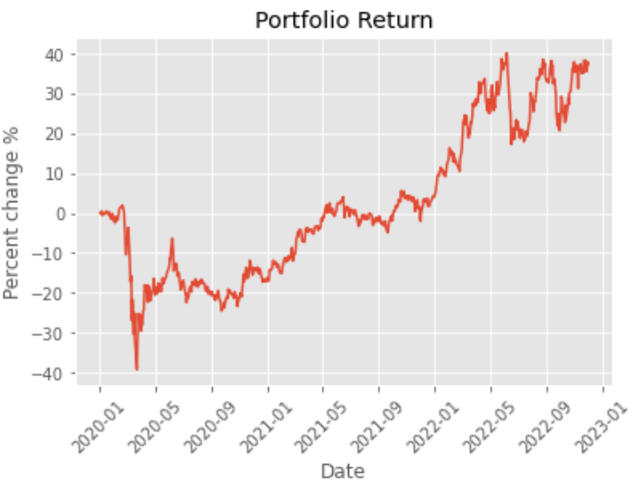
Portfolio Performance
30%
70%

Slide 8

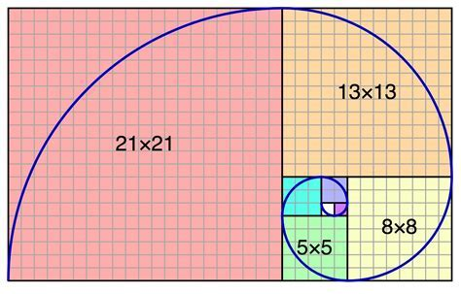

Fibonacci Retracement
Overview / Description
The Fibonacci Retracement is named after Italian mathemicatian, Leonardo Pisano and based off on the Fibonacci Sequence Support and Resistance levels: Represents an increase and decrease in demand 0, 1, 1, 2, 3, 5, 8, 13, 21, 34, 55, 89, 144, 233, … The Fibonacci Retracements are: 23.6%, 38.2%, 50%, 61.8%, and 78.6%
Golden Ratio $\left(φ\right): \sim 1.61$
Notes:
Risk Adj: CAPM (MRP*.98)+RF
Active Management: HPR – Risk Adj Return

Slide 9
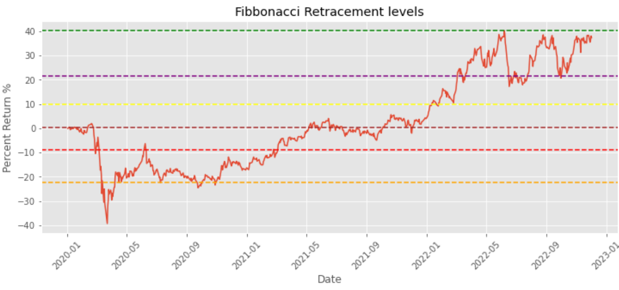
Fibonacci Retracement Level Results
China
Covid-19
Inflation Data
Oil Prices Rose
30%
Vaccines Announced
70%

Slide 10
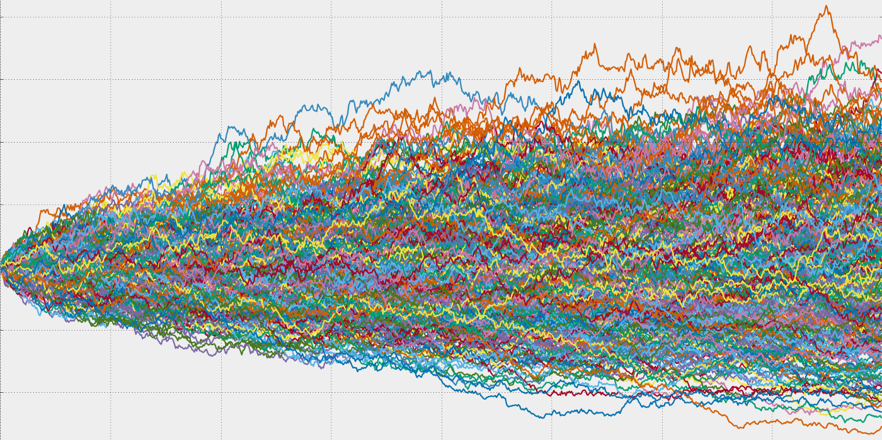
Monte Carlos Simulation
Overview / Description
Named after a famous gambling location in Europe called Monaco Tool/Algorithm that is used to predict the probability of a variety of outcomes when random variables are present. Used in a variety of things such as gambling, investing, experiments, etc.
MCS Structure
Predictive Model: establishes dependent and independent variables
Specifying Probability Distribution: uses historical data to create a range of an unknown variable from happening
The Simulation: generates and presents the results
Notes:
Risk Adj: CAPM (MRP*.98)+RF
Active Management: HPR – Risk Adj Return

Slide 11
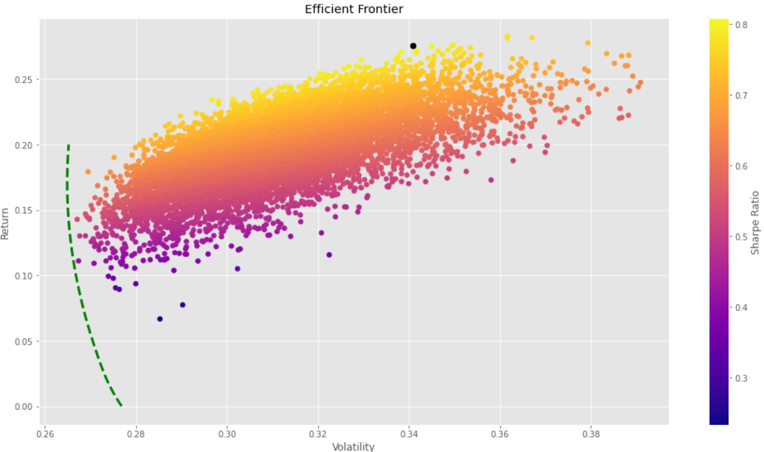
Trial 1
Optimal Portfolio Weight (#8965)
ExxonMobil (XOM) | 27.07%
Chevron (CVX) | 2.76%
Kinder Morgan (KMI) | 0.48%
Constellation Energy Corp (CEG) | 43.41%
Dominion (D) | 0.67%
Duke (DUK) | 7.27%
Energy ETF (XLE) | 18.34%
Trial 1 Summary Statistics (#8965):
Highest Rate of Return: 39.09%
Lowest Rate of Return: 26.23%
Highest Sharpe Ratio: 0.81
Lowest Sharpe Ratio: 0.23
30%
70%

Slide 12
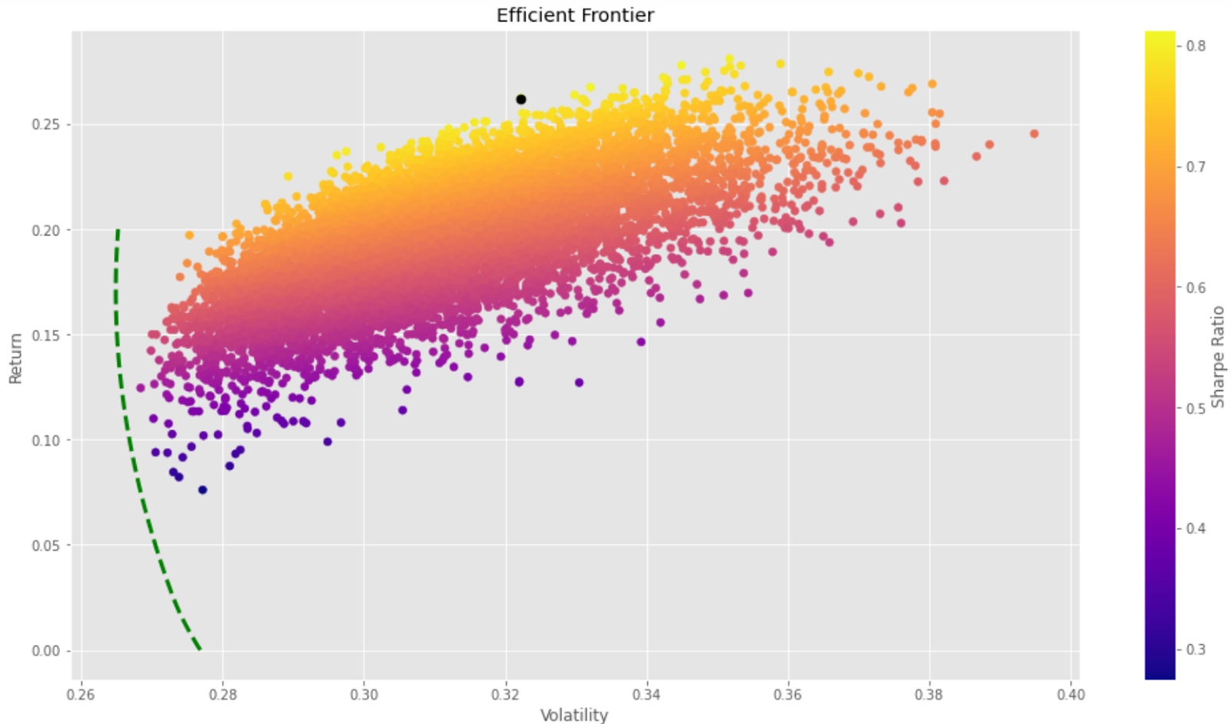
Trial 2
Optimal Portfolio Weight (#4123)
ExxonMobil (XOM) | 39.38%
Chevron (CVX) | 28.34%
Kinder Morgan (KMI) | 0.85%
Constellation Energy Corp (CEG) | 26.65%
Dominion (D) | 1.45%
Duke (DUK) | 2.42%
Energy ETF (XLE) | 0.91%
Trial 2 Summary Statistics (#4123):
Highest Rate of Return: 39.50%
Lowest Rate of Return: 26.70%
Highest Sharpe Ratio: 0.81
Lowest Sharpe Ratio: 0.31
30%
70%

Slide 13

Trial 3
Optimal Portfolio Weight (#5867)
ExxonMobil (XOM) | 29.74%
Chevron (CVX) | 1.82%
Kinder Morgan (KMI) | 0.76%
Constellation Energy Corp (CEG) | 34.81%
Dominion (D) | 0.12%
Duke (DUK) | 16.14%
Energy ETF (XLE) | 16.61%
Trial 3 Summary Statistics (#5867):
Highest Rate of Return: 39.49%
Lowest Rate of Return: 26.84%
Highest Sharpe Ratio: 0.81
Lowest Sharpe Ratio: 0.27
30%
70%
Source: Bloomberg , Company Financials, and Investor Presentations
Data as of 1/28/21 – 1/28/22

Slide 14
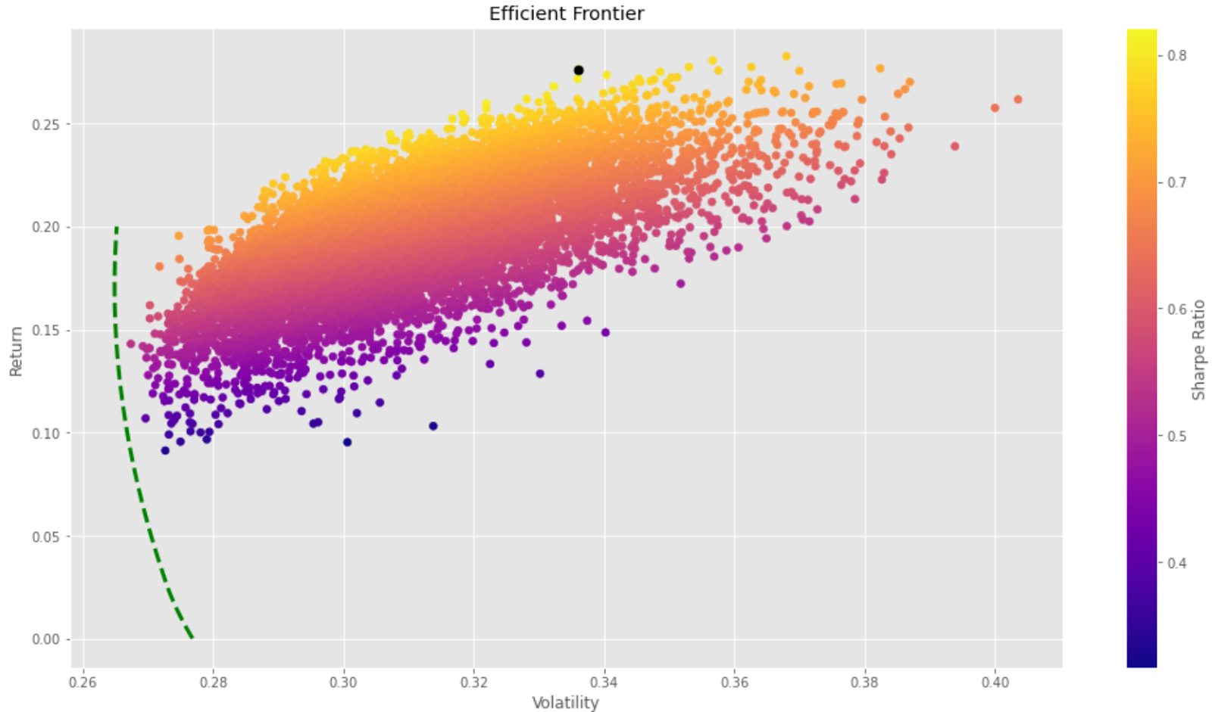
Trial 4
Optimal Portfolio Weight (#9993)
ExxonMobil (XOM) | 34.83%
Chevron (CVX) | 24.94%
Kinder Morgan (KMI) | 1.34%
Constellation Energy Corp (CEG) | 31.71%
Dominion (D) | 0.27%
Duke (DUK) | 6.27%
Energy ETF (XLE) | 0.60%
Trial 4 Summary Statistics (#9993):
Highest Rate of Return: 40.36%
Lowest Rate of Return: 26.74%
Highest Sharpe Ratio: 0.82
Lowest Sharpe Ratio: 0.32
30%
70%

Slide 15
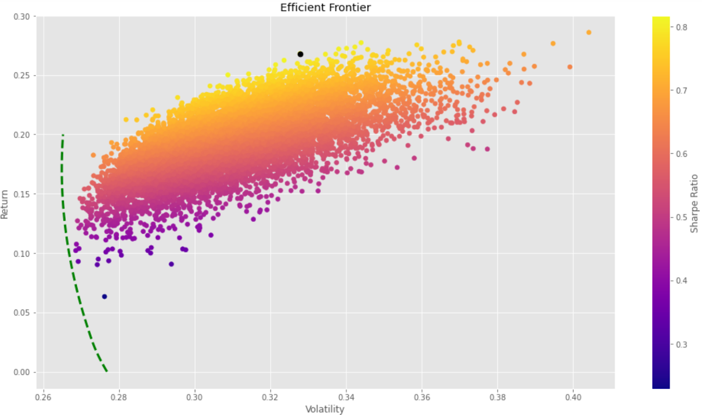
Trial 5
Optimal Portfolio Weight (#4343)
ExxonMobil (XOM) | 34.56%
Chevron (CVX) | 21.38%
Kinder Morgan (KMI) | 0.82%
Constellation Energy Corp (CEG) | 26.98%
Dominion (D) | 0.05%
Duke (DUK) | 12.13%
Energy ETF (XLE) | 4.07%
Trial 5 Summary Statistics (#4343):
Highest Rate of Return: 40.41%
Lowest Rate of Return: 26.86%
Highest Sharpe Ratio: 0.82
Lowest Sharpe Ratio: 0.22
30%
70%
Source: Bloomberg , Company Financials, and Investor Presentations
Data as of 1/28/21 – 1/28/22

Slide 16
Results
Fibonacci Retracement Levels
Fibonacci Retracement Levels supports our theory and appears in places of large macroeconomic events
Sharpe Ratio
After 50,000 simulations, the optimal Sharpe Ratio for the portfolio is 0.82 with an average return of 39.77% over the course of 5 trials
Optimal Portfolio Weights
Stock performance from best to worst: XOM, CEG, XLE, CVX, DUK, KMI, and D. Having a majority in top 3-4 companies lead to the best results

Slide 17
Analysis and Improvements
Simulation VS Current Portfolio
On average, portfolio returns can increase ~2 - 3% (37% to 39.77%) by changing portfolio weights
Errors in Historical Data
“Past performance is not indicative of the future”. Difficult to predict systematic and unsystematic risks. Variables not accounted for (FED’s Monetary policy)
Back testing with conditions
Energy sector vs tech or consumer sector. The variables of the energy sector are far different than others

Slide 18
Questions?

